Slide 1


MUSIC RECOMMENDER USING FACIAL EXPRESSION

Slide 2
Submitted in the partial fulfillment for the award of the degree of BACHELOR OF ENGINEERING IN COMPUTER SCIENCE – AIML
Submitted by:
ADITI GUPTA - 20BCS6471

Slide 3

CONTENTS
Abstract
Introduction
Existing System
Problem Formulation
Proposed System
Methodology
Results
Conclusion
References

Slide 4

ABSTRACT
Human emotion play a vital role in recent times. Emotion is based on human feelings which can be both expressed or not.
The objective of this project is to extract feature from human face and detect emotion, and to play music according to the emotion detected.
However, many existing techniques use previous data to suggest music and the other algorithms used are normally slow, usually they are less accurate and it even require additional hardware like EEG or physiological sensors.
Facial expressions are captured a local capturing device or an inbuilt camera. Here we use algorithm for the recognition of the feature from the captured image. Thus, the proposed system is based on the facial expression captured and will music will be played automatically.

Slide 5
INTRODUCTION
In our project music is recommended to the user by detecting the real time capturing of user's emotions.
we proposed a system to redirect the user to YouTube after detecting the emotion of user different categories such as happy, sad or angry etc.
Emotion-Based-music-player It's music player designed by Streamlit as front-End which make our project user friendly it has the capability to detect emotions i.e, the face of user with the help of machine learning algorithm using python.
In this application image of a person is captured using a real time machine that has the access to the local machinery and depending on the captured image it compares the database data sets that already saved in the local device

Slide 6
Existing techniques use previous data to suggest music and the other algorithms used are normally slow, usually they are less accurate and it even require additional hardware like EEG or physiological sensors Existing technique were using collaboration technique which will use previous user data to recommend music and This technique requires lot of manual work
Existing
System

Slide 7
Existing techniques use previous data to suggest music and the other algorithms used are normally slow, usually they are less accurate and it even require additional hardware like EEG or physiological sensors Existing technique were using collaboration technique which will use previous user data to recommend music and This technique requires lot of manual work
Problem Formulation

Slide 8
Humans have a tendency to show their emotions unknowingly mainly they reflect the face 1. This project mainly focuses on the user's preferred music that is recommended due to the emotional awareness 2. Once the application starts working it takes input from user like enter the language and singer name. 3. After clicking on recommend me a song button it automatically captures images with the webcam or any other physiological devices. 4. After detecting mood it redirect user to YouTube and show the playlist of song . Songs make the user mood better and music is one of the best aid to change the mood.
Proposed System

Slide 9
Methodology
The main objective of this session is to capture images so here we are using the common device i.e, webcam or can use any other physiological devices. for that purpose we are using the computer vision library. This makes it easier to integrate it with other libraries which can also use Numpy.
The face recognition is considered as one of the best way to determine a person's mood. For detecting face we use mediapipe library. MediaPipe is an open-source, cross-platform Machine Learning framework It can be used to make cutting-edge Machine Learning Models like face detection, multi-hand tracking, object detection, and tracking, and many more
FACE
CAPTURING
FACE
DETECTION
When the face is detected successfully, it draw some landmarks on face and hands to extract the face and hands for the further analysis. In the next step It is performs the comparision between the input data and with stored one so it can predict the class that contain the emotion. If it contains one of the five emotions anger, sad, neutral, happy or Rockrock.
The input images that is acquired is from the web camera and is used to capture real-time images. After detect emotion redirect to YouTube and suggest music according to its emotion.
EMOTION CLASSIFICATION
MUSIC RECOMMENDATION:

Slide 10
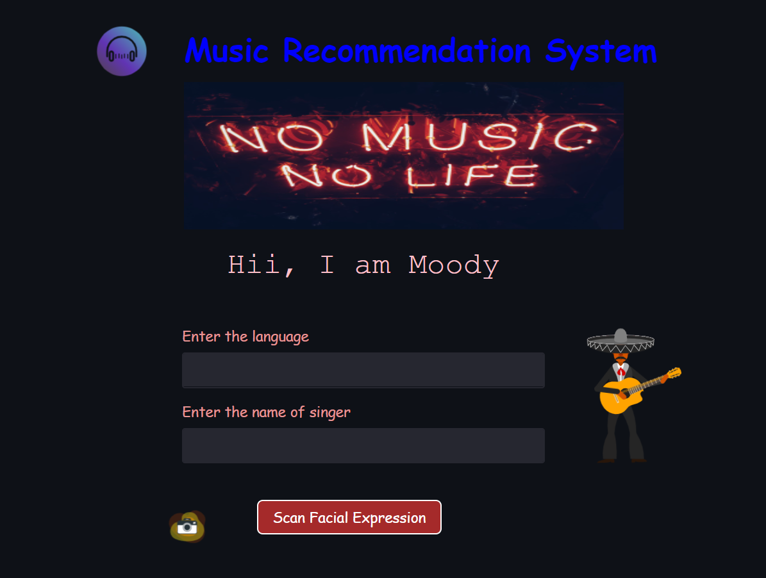
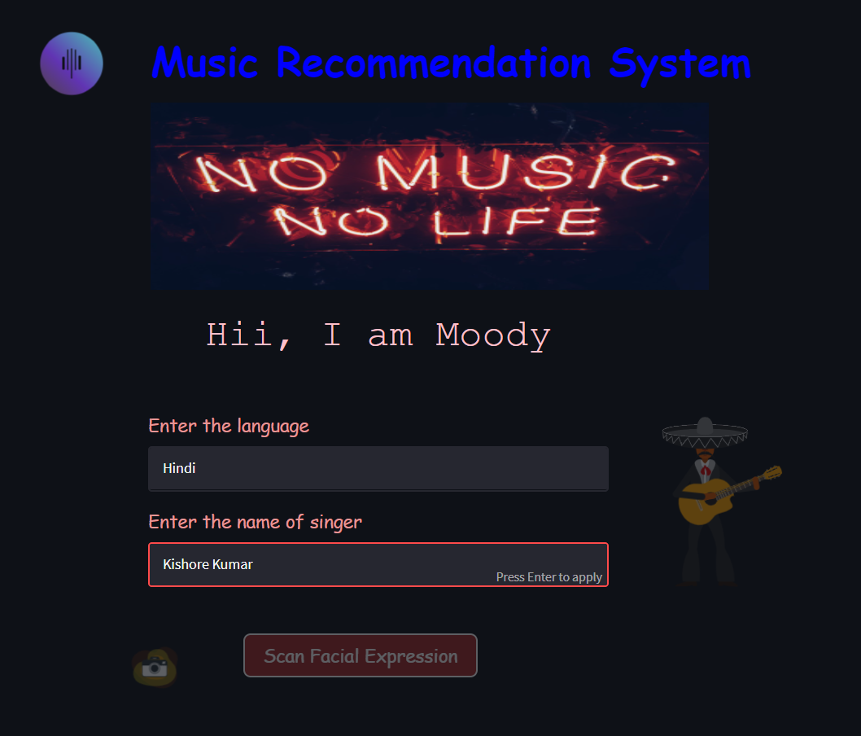
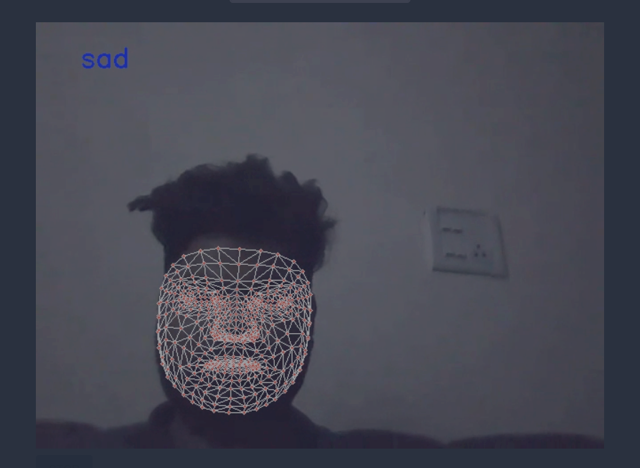
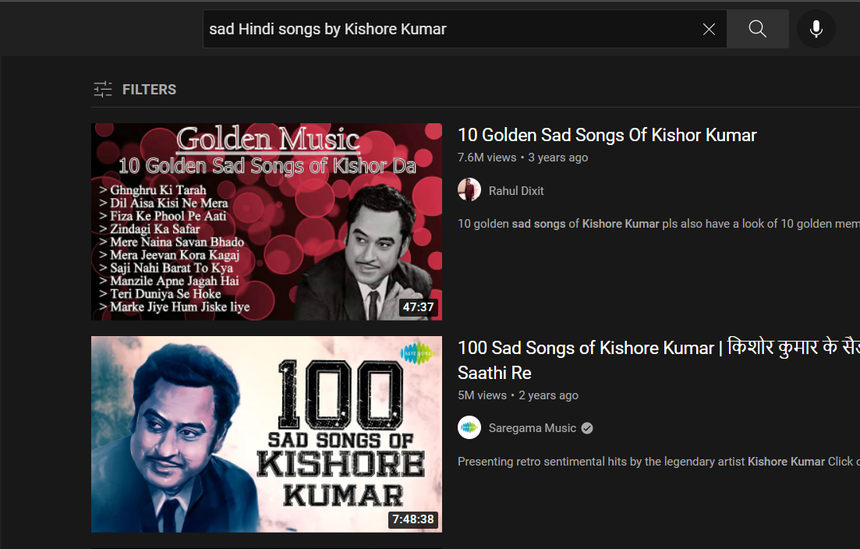
Results
This is user’s interface
User enter some inputs like language and singer
Music
Recommendation
System
Detecting Emotions
Suggests Music

Slide 11
Conclusion
In this project, music recommendation model it is based on the emotions that are captured in real time images of the user.
This project is designed for the purpose of making better interaction between the music system and the user
Music is helpful in changing the mood of the user and and for some people it is a stress reliever
Recent development it shows a wide prospective in the developing the emotion based music recommendation system.

Slide 12

Refrences
[1] Hemanth P,Adarsh ,Aswani C.B, Ajith P, Veena A Kumar, “EMO PLAYER: Emotion Based Music Player”, International Research Journal of Engineering and Technology (IRJET), vol. 5, no. 4, April 2018, pp. 4822-87.
[2] Music Recommendation System: “Sound Tree”, Dcengo Unchained: Sila KAYA, BSc.; Duygu KABAKCI, BSc.; Işınsu KATIRCIOĞLU, BSc. and Koray KOCAKAYA BSc. Assistant : Dilek Önal Supervisors: Prof. Dr. İsmail Hakki Toroslu, Prof. Dr. Veysi İşler Sponsor Company: ARGEDOR
[3] Tim Spittle, lucyd, GitHub, , April 16, 2020. Accessed on: [Online], Available at: https://github.com/timspit/lucyd
[4] A. Abdul, J. Chen, H.-Y. Liao, and S.-H. Chang, “An Emotion-Aware Personalized Music Recommendation System Using a Convolutional Neural Networks Approach,” Applied Sciences, vol. 8, no. 7, p. 1103, Jul. 2018.
[5] Manas Sambare, FER2013 Dataset, Kaggle, July 19, 2020. Accessed on: September 9, 2020. [Online], Avalilable at: https://www.kaggle.com/msambare/fer2013

Slide 13

Thank You

